Slide 1
Pricing Perpetual Protect
DBA5102 · BLOCKCHAIN GROUP ASSIGNMENT · OPTION 2
A fair-value pricing model for Jasper Vault’s short-dated BTC protection
Subham Kundu
Aman Raj Mohta
Keerthivasan Radhakrishnan
A0353711L
A0356637R
A0356481X
Maksim Silchenko
Aarogya Banepali
Zhang Jiahe
A0314846Y
A0354365Y
A0350722M
October 2026
Notes:
Welcome. We are pricing Jasper Vault’s Perpetual Protect product: short-dated protection on BTC. In ten minutes we walk through the problem, what the data showed us, the model we chose and why, how it performs, how we manage risk, and what we could not measure.

Slide 2
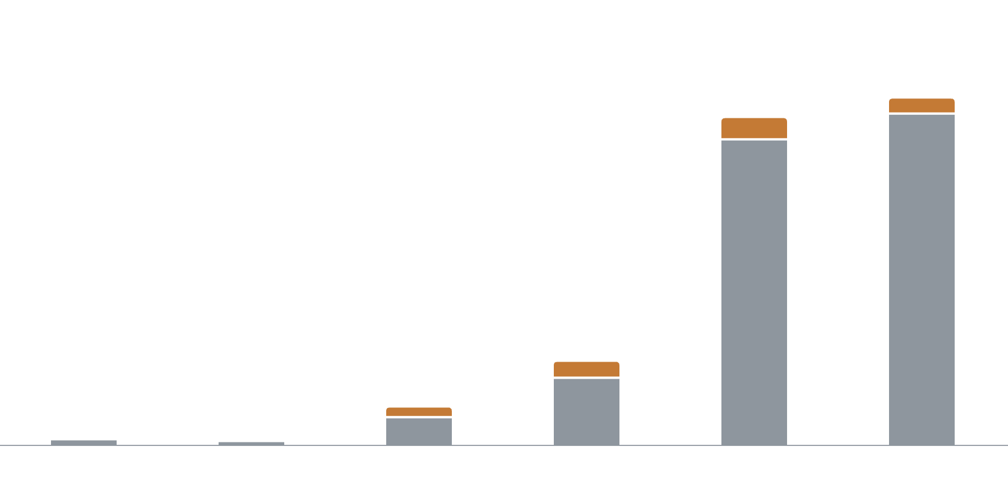
JV keeps only 7% of the premium it collects
01 · THE PROBLEM
What Perpetual Protect is
Monthly premium and JV’s profit (USDC)
A trader pays a premium for protection lasting 30 minutes to 24 hours. If BTC moves against the trader, JV pays out the move.
Paid out to traders
Kept by JV (profit)
+6,257
of 101.6K
+4,319
of 107.8K
How JV prices it today
A Black-Scholes base price plus a markup from trading signals (RSI and Bollinger bands).
+4,620
of 25.4K
Our task
+2,645
of 11.1K
Price 4,155 new orders (31 Jul – 14 Oct 2026) “cheap and good”. JV’s rule: simply raising every price is not a solution.
−453
of 1.1K
+49
of 1.1K
Feb
Mar
Apr
May
Jun
Jul
Bar height = premium collected. Orders grew from 211 (Feb) to 2,571 (Jul) and premium from 1.1K to 107.8K USDC, but profit stayed small.
Jasper Vault · Perpetual Protect pricing
2
Notes:
Perpetual Protect is short-dated protection on BTC: a trader pays a premium, and if BTC moves against them within the protection window, Jasper Vault pays out the move. Today JV prices it as a Black-Scholes base price plus a markup from trading signals. The chart shows each month’s premium split into what JV paid out (grey) and what it kept (orange). Volume grew fast: from 211 orders and 1.1 thousand USDC of premium in February to 2,571 orders and 108 thousand USDC in July. But profit stayed small, between a loss of 453 and a gain of 6,257 USDC a month. Over February to July, JV collected 248 thousand USDC and paid out 231 thousand, so it kept only about 7 percent. Our job was to price 4,155 new orders “cheap and good”, and JV was clear that simply raising every price is not a valid answer.

Slide 3
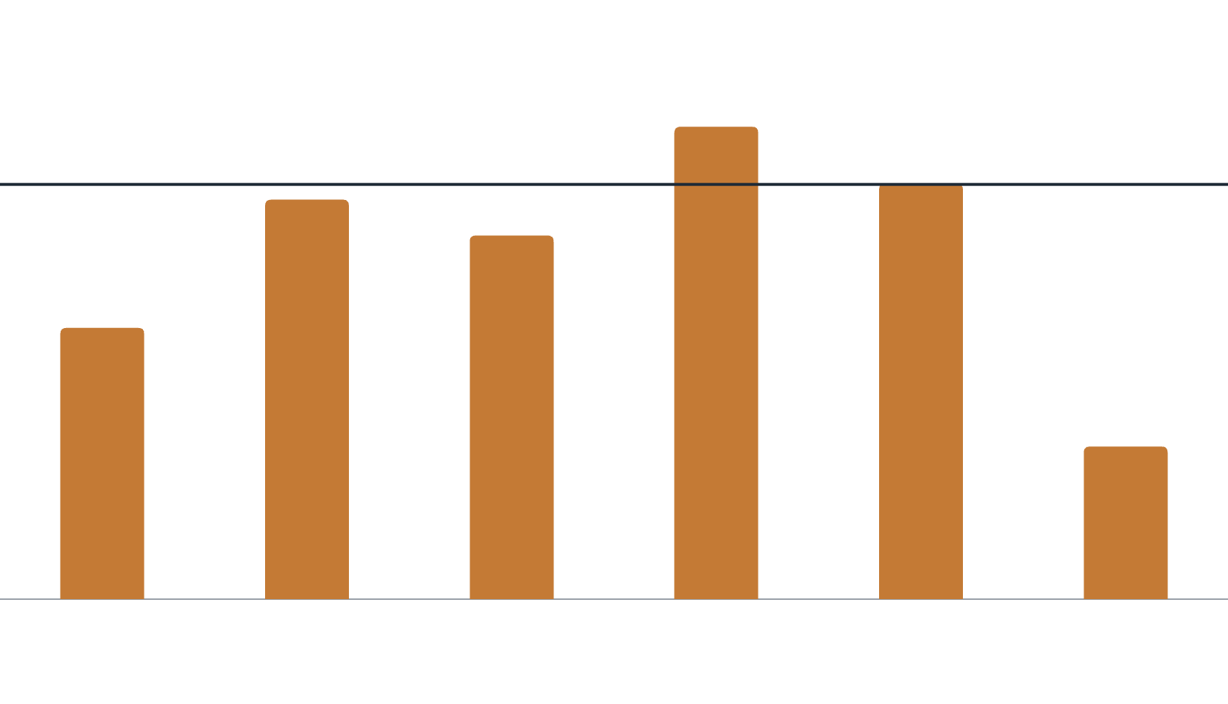
Risk is uneven: by product, by hour and by day
02 · WHAT THE DATA SHOWED
JV’s loss ratio by product, Feb–Jul
Loss ratio = payouts ÷ premiums. Above 1.0, JV loses money.
Products differ
JV loses money on 4-hour orders and earns a lot on 30-minute and 24-hour orders.
1.14
0.96
1.00
0.88
Break-even
Hours differ
0.65
BTC is far more volatile just after the New York stock market opens (3.8× the weekly average variance). JV’s base price ignores this.
0.37
A few days decide the result
The top 1% of orders took 33% of all payouts. JV’s five worst days lost 25,409 USDC, more than its whole six-month profit of 17,437 USDC.
30 min
1 h
2 h
4 h
8 h
24 h
Jasper Vault · Perpetual Protect pricing
3
Notes:
Three things stood out in the training data. First, risk differs by product: JV pays out more than it collects on 4-hour orders, but keeps most of the premium on 30-minute and 24-hour orders. (The 12-hour product has only 46 orders and is left out of the chart.) Second, risk differs by hour: BTC moves far more just after the New York stock market opens, and JV’s base price does not account for that. Third, a handful of orders and days decide the result: the top 1% of orders took a third of all payouts, and JV’s five worst days lost more than its whole six-month profit. A good price should follow these patterns.

Slide 4

Model the expected payout, then add a fair margin
03 · OUR APPROACH
Step 1
Step 2
Step 3
Step 4
Forecast the BTC move
Turn it into fair value
Add a 25% margin
Keep a floor
Black-Scholes converts the move into the order’s expected payout.
Fair value × 1.25, so payouts are about 80% of premium on average.
Never charge less than JV’s current base price.
Uses recent volatility, the time of day and scheduled US data releases.
Example: 16 June 2026, a 1-hour put on 0.17 BTC
Expected move
Fair value
With margin (× 1.25)
Premium for 0.17 BTC
0.66%
217.85 USDC per BTC
272.31 USDC per BTC
46.35 USDC
JV charged 28.23 USDC and this order paid out 84.07 USDC, so both prices lost here. A price is judged on thousands of orders, not one.
Jasper Vault · Perpetual Protect pricing
4
Notes:
Our final model, built by Maksim, follows one simple idea: work out what an order is expected to pay out, then add a margin. Step 1 forecasts how far BTC will move during the protection window, using recent volatility over four horizons, the time of day in New York, and scheduled US releases such as CPI, the jobs report and Fed decisions. Step 2 turns that move into fair value, the expected payout, with the Black-Scholes formula. Step 3 adds a 25% margin. Step 4 never lets the price fall below JV’s current base price. This matches the pricing idea from the course: choose the price that maximises demand times the margin over expected cost. The example shows one real order. It also lost money, at our price and at JV’s, which is why we judge a model on thousands of orders.

Slide 5
Step 1 in detail: forecasting the BTC move
03 · OUR APPROACH
1. What data we collected
2. How the model predicts
3. How we checked it
1-minute BTC/USDC price candles, 1 Jan – 14 Oct 2026 (412,080 candles), supplied with the case
The schedule of US releases (CPI, jobs report, Fed decisions), taken from the official release pages
Only candles that closed before an order was placed, so no future data leaks in
Target: how far BTC moved in past windows of the same length, sampled every 5 minutes
Inputs: recent volatility (1 h, 4 h, 1 day, 1 week), time of day in New York, and a US release inside the window
One Poisson regression per product length gives the expected size of the move
Walk-forward: each month forecast by a model fitted only on earlier months
Payouts ÷ fair value = 0.98 over Feb–Jul, where 1.0 means on target (0.85 to 1.41 by month)
Tested and dropped: order size, direction, volatility regimes, US holidays, news and sentiment
Jasper Vault · Perpetual Protect pricing
5
Notes:
This slide opens up Step 1, the forecast of how far BTC will move. Data: we used the 1-minute BTC/USDC candles supplied with the case, from January to mid-October 2026, and a calendar of scheduled US releases (CPI, the jobs report and Fed decisions) taken from the official release pages. For every order we only use candles that had already closed before the order was placed, so the model never sees the future. Prediction: we look back at many past windows of the same length, one every five minutes, and record how far BTC moved in each. A Poisson regression, one per product length, learns how that move size depends on recent volatility over four horizons, the time of day in New York, and whether a release falls inside the window. Its output is the expected size of the move, which Step 2 turns into fair value. Checks: every month is forecast by a model fitted only on earlier months. Over February to July, actual payouts were 0.98 times fair value, close to the target of 1.0, although single months ranged from 0.85 to 1.41. Order size, direction, volatility regimes, US holidays, and news and sentiment were all tested and dropped because they did not improve the forecast reliably.

Slide 6
Five ideas tested, one simple model chosen
04 · HOW WE CHOSE
Idea | Built by | What we found | Decision
Fair value × 1.25: forecast the move, add a margin | Maksim | Beat JV in all six training months and ranks risk well | Chosen as the core
Order-flow loading: charge more against JV’s crowded side | Chris | Those orders pay out more, but a flat raise of the same size did as well | Optional add-on and risk signal
Hybrid: JV’s base price × a learned multiplier, plus an adjustment | Subham | A simple “base × one constant” benchmark earned more | Kept as a cross-check
Our estimate of JV’s price × a risk shape | Aman | Kept JV’s price level, but earned less than JV in July | Not adopted
News, social media, LLM signals and extra market data | Jay, Aman | Better forecasts at best, never better prices | Not adopted
All five were scored on the same orders. July was held out, and each adoption rule was written down before scoring.
Jasper Vault · Perpetual Protect pricing
6
Notes:
Each team member built and tested a different idea, and we compared them on the same orders against JV’s six criteria: profit, sensible pricing factors, market conditions, commercial reasonableness, performance on unseen data, and practicality. Maksim’s fair-value model was the only one to meet all six, so it became the core. Chris found a real signal in JV’s open book: orders that go against the crowded side pay out more. But a flat price rise of the same size did just as well, so we keep it as an optional add-on and a risk signal. Subham’s hybrid was beaten by its own simple benchmark. Aman’s version kept JV’s price level but earned less than JV in July. News, social media and LLM signals, and extra market data such as implied volatility, improved forecasts at best but never improved prices. To stay honest, July was held out and every adoption rule was written down before we looked at the scores.

Slide 7
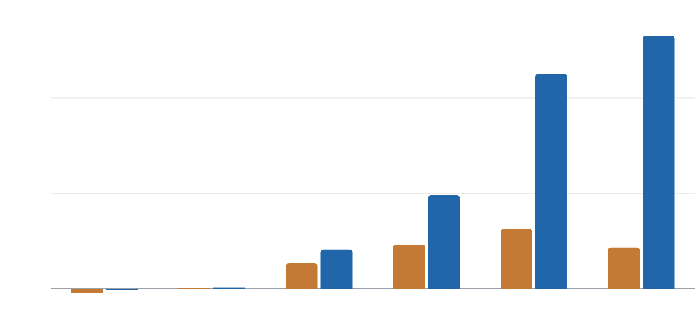
The model beats JV’s price in every training month
05 · RESULTS
JV’s actual price
Our model, fitted only on earlier months
July, if buyers behave as before
+22,187 USDC vs JV
26,506
22,514
90% range: +15,472 to +29,549
20K
July, if higher prices lose some buyers
+10,782 USDC vs JV
90% range: +3,506 to +18,719
10K
The main risk
If buyers only accept prices no higher than JV’s, the model earns 3,715 USDC in July against JV’s 4,319.
0
Feb
Mar
Apr
May
Jun
Jul
Profit per month in USDC, buyers assumed to behave as before. Each month is priced by a model fitted only on earlier months.
Jasper Vault · Perpetual Protect pricing
7
Notes:
We tested the model the way it would be used: each month priced by a model fitted only on the months before it. With buyers behaving as before, the model made more than JV’s actual prices in every month from February to July. In July it made 22,187 USDC more, and the 90% range from resampling whole days stays well above zero. Since we cannot observe demand, we also assumed that higher prices lose some buyers; the model still made 10,782 USDC more in July. The honest caveat: if buyers only accept prices no higher than JV’s, the model earns slightly less than JV in July. That is the main commercial risk, and it is why demand needs to be measured.

Slide 8
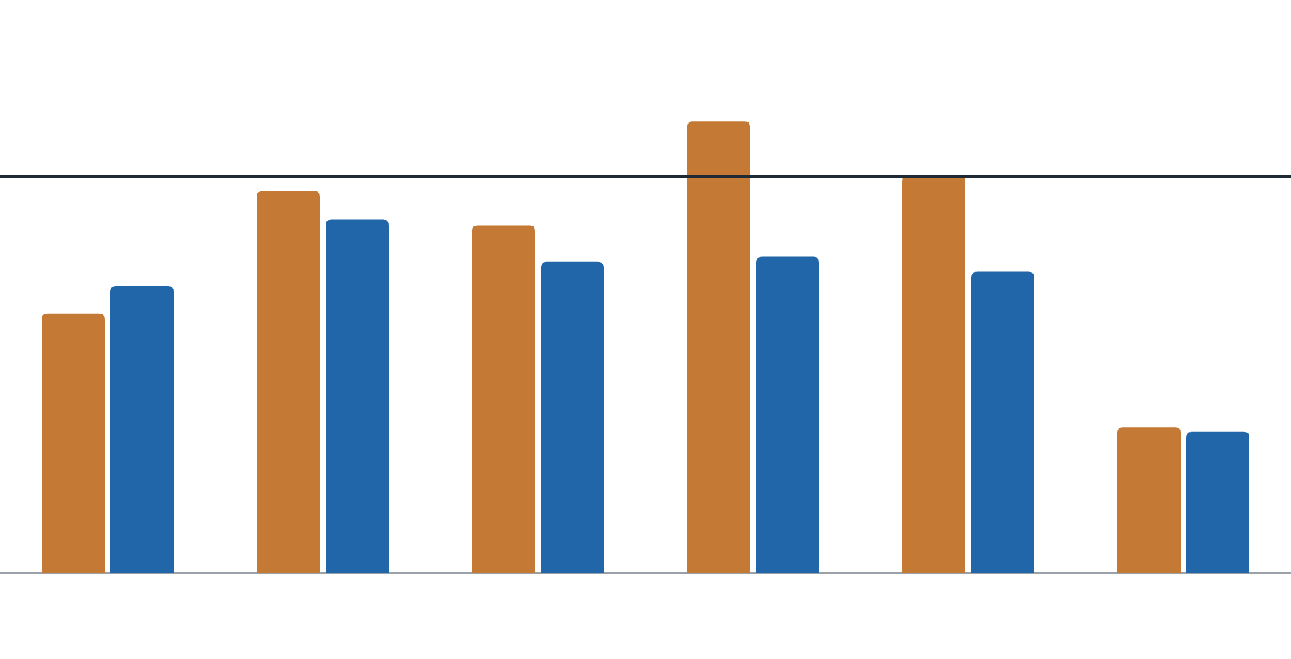
Prices move to where the risk is
06 · BETTER, NOT JUST HIGHER
Loss ratio at JV’s actual price
At our model’s price
58% of orders
get a lower price than JV charged (66% in July)
1.14
1.00
0.957 × JV’s price
0.80
Break-even
on the 544 August orders where JV’s own price is visible
0.72
0.76
0.65
It ranks risk
Orders the model prices higher really do pay out more, in training and in July.
In training the model charged 1.17–1.21× JV on average, and a flat raise to the same total did about as well. Its edge: it needs no JV price and puts the price where the risk is.
30 min
1 h
2 h
4 h
8 h
24 h
Payouts ÷ premiums by product, Feb–Jul, on the same orders with buyers assumed to behave as before.
Jasper Vault · Perpetual Protect pricing
8
Notes:
JV told us that raising every price is not a solution, so we checked that the model prices better, not just higher. The chart shows the loss ratio by product. At JV’s price, 4-hour orders lose money and 8-hour orders only break even. At the model’s price, every product sits well below break-even, because the model charges more where the risk is and less where it is not. 58% of orders actually get a lower price than JV charged. On the 544 August orders where we can see JV’s own price, the model is about 4% cheaper overall. The model also ranks risk: the orders it prices higher really do pay out more. To be fair, in training the model charged about 17 to 21% more than JV on average, and a flat raise to the same total did about as well there. The model’s advantage is that it needs no JV price at all and sets each price from the risk of that order.

Slide 9
Cap the exposure instead of raising every price
07 · RISK
Why a cap
Exposure cap trade-off, Feb–Jul (USDC)
JV’s gain on an order is limited to the premium; its loss is not. Losses bunch on a few trending days that no price can foresee.
Rule | Profit | Premium turned away | Worst day
No cap | 62,879 | 0% | −8,399
Cap at 400,000 | 61,653 | 2% | −8,399
Cap at 250,000 (recommended) | 55,753 | 15% | −6,594
Cap at 150,000 | 44,168 | 34% | −4,814
Recommendation
Pause new sales in one direction once open protection exceeds 250,000 USDC.
Costs 11% of profit; the worst day improves from −8,399 to −6,594 USDC.
Buyers assumed to behave as before. On the 4,155 new orders, the 250,000 cap would pause 9.4% of orders (30% of premium). A minute-by-minute hedge was also tested: its fees cost more than it saved.
Jasper Vault · Perpetual Protect pricing
9
Notes:
JV earns at most the premium on each order, but its loss is open-ended, and losses bunch on a few days when BTC trends and the crowd is right. No price set at the time of an order can foresee those days, so we manage that risk with a separate rule rather than by raising prices. Maksim’s exposure cap pauses new sales in one direction while open protection in that direction is above a limit. The table shows the trade-off on training data: a 250,000 USDC cap gives up about 11% of profit and improves the worst day from −8,399 to −6,594 USDC. The cap size is really JV’s choice of risk appetite. Chris’s order-flow signal supports this: orders that go against JV’s crowded side pay out more, which is exactly when exposure builds up.

Slide 10
What we could not measure, and what comes next
08 · LIMITATIONS AND FUTURE WORK
Limitations
Future work
Demand is unknown
Measure demand
Every buyer-response rule is an assumption. If buyers only accept prices no higher than JV’s, the model does not beat JV in July.
Run a small randomised price test, for example ±10% on 10% of quotes.
Use JV’s live order book
Trending months lose at any price
Run the exposure cap, and add the order-flow loading once it beats a flat raise.
A one-off check after the prices were frozen: August lost 12,667 USDC as BTC rose 25%, and JV’s own prices also lost where visible. September and October were profitable.
Keep it calibrated
Refit monthly and track payouts ÷ fair value (1.23 on the new orders).
Gross profit only
Fees, funding and capital costs are not included.
Other strikes and on-chain use
The same formula prices out-of-the-money protection, and the model can run off-chain with an oracle price feed.
Small groups
12-hour, 24-hour and release-window orders number only tens to a few hundred.
Jasper Vault · Perpetual Protect pricing
10
Notes:
The biggest limitation is demand: our data only contains orders that were bought, so we cannot see how many traders a higher price would drive away. Every buyer-response rule we used is an assumption. Second, trending months can lose money at any price. After the prices were frozen, the team ran one agreed check on the new orders: August lost money as BTC rose 25%, and JV’s own prices lost money too where we can see them, while September and October were profitable. No price was changed after that check. Third, we report gross underwriting profit only, without fees, funding or capital costs. And some groups, like 12-hour and 24-hour orders, are small. For future work, the most valuable step is a small randomised price test to measure demand directly. JV can also use its live order book for the cap and the order-flow loading, refit the model monthly, and extend it to out-of-the-money strikes and on-chain deployment through an oracle.

Slide 11
Model the payout, add a fair margin, cap the risk
09 · CONCLUSION
1
2
3
Price each order at fair value × 1.25, never below JV’s base price
Cap open protection at 250,000 USDC per direction
Run a small price test before changing the margin
4,155 new orders priced, 205,824 USDC in total, about 4% below JV where its price is visible.
The worst training day improves from −8,399 to −6,594 USDC for 11% of profit.
Measure how many buyers a higher or lower price wins or loses.
Thank you. Questions are welcome.
Notes:
To conclude: we recommend that JV price each Perpetual Protect order from its expected payout plus a 25% margin, never below the current base price. That gives 4,155 prices for the new orders, about 4% below JV’s own prices where we can see them, while beating JV in every training month. Second, manage the trending-day risk with an exposure cap of 250,000 USDC per direction rather than by raising prices. Third, before changing the margin, run a small price test to learn how buyers actually respond. Thank you.

